Slide 1
Kubernetes

Slide 2
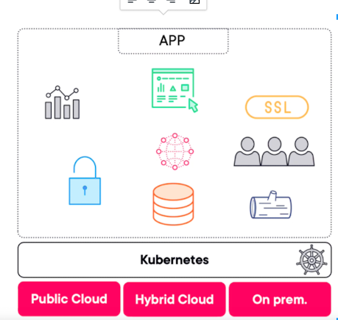
Why do we need Kubernetes?
It’s a layer of indirection between cloud compute/storage/networking

Slide 3
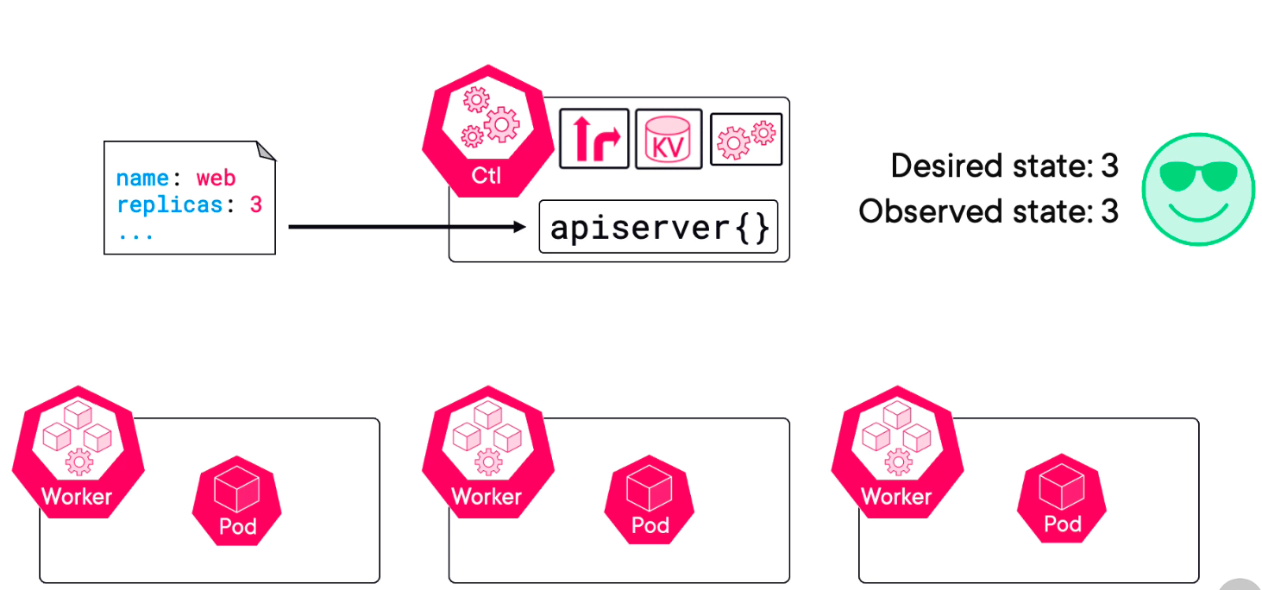
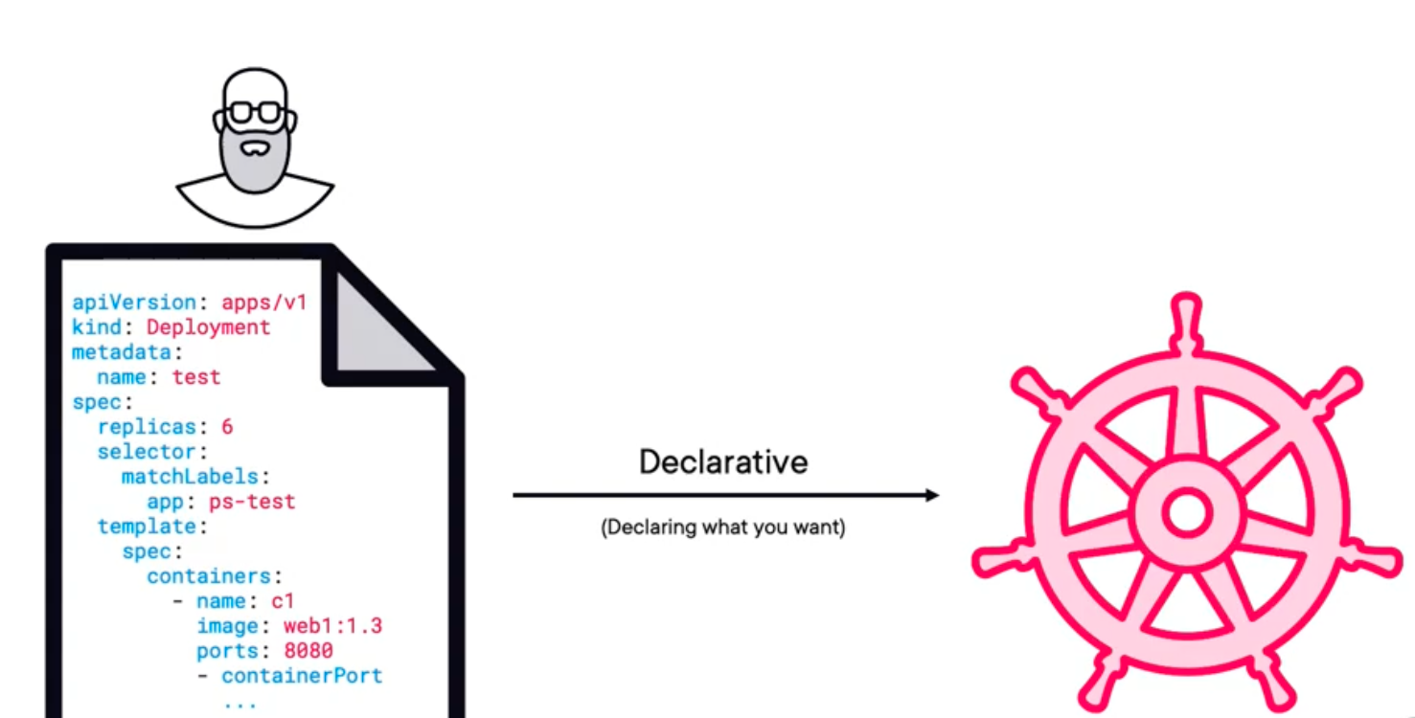
The desired state:

Slide 4
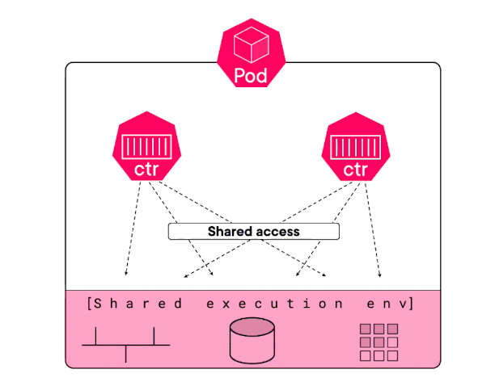
Pod (Replica)
1. Basic deployment unit - atomic unit of the deployment. 2. Shared execution environment for one or more containers, sharing resources like mounts, IPs etc.

Slide 5
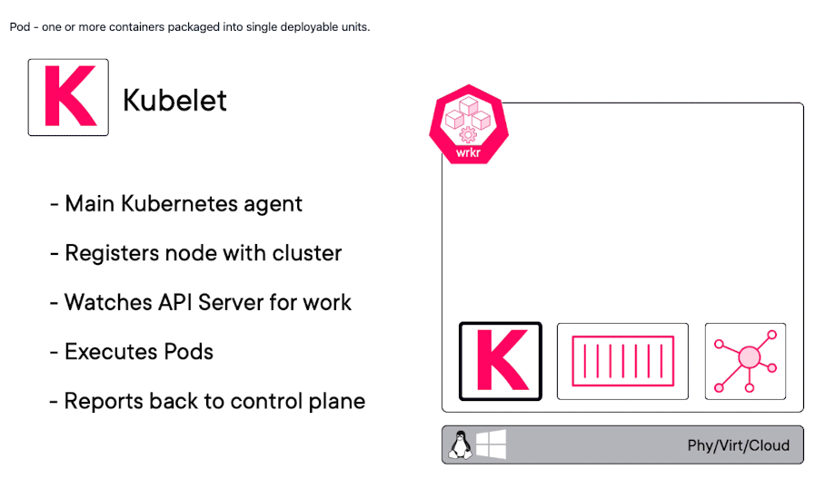
Kubelets:

Slide 6
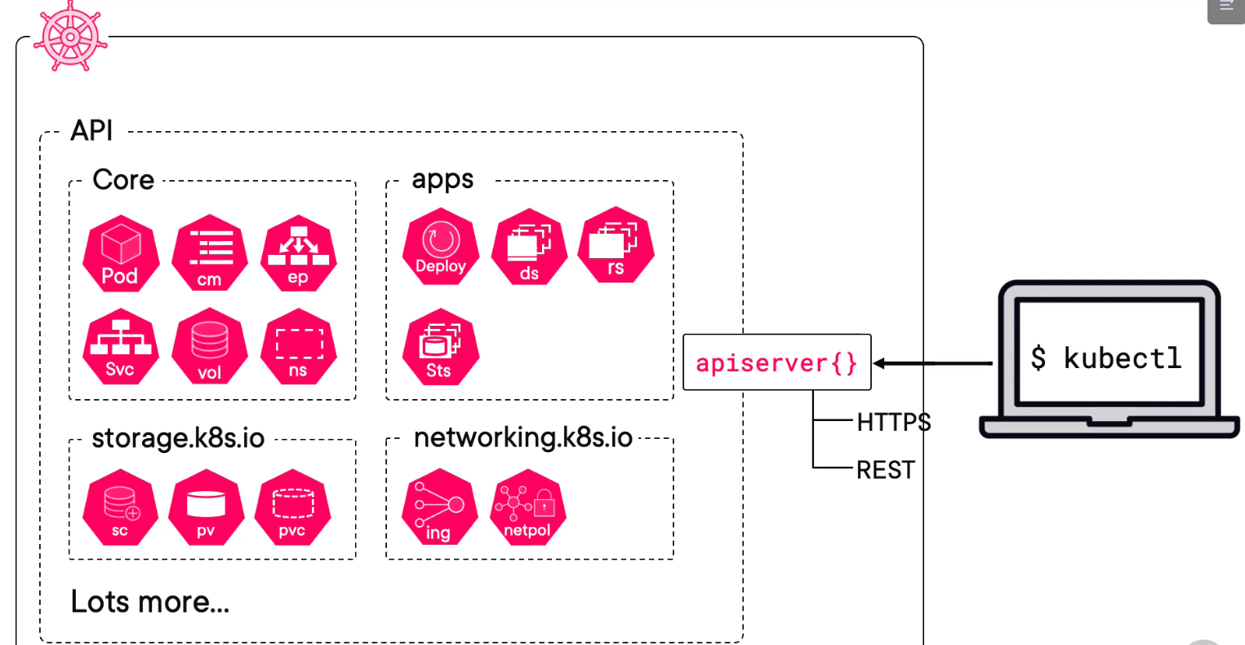
Who kubelets report to?

Slide 7
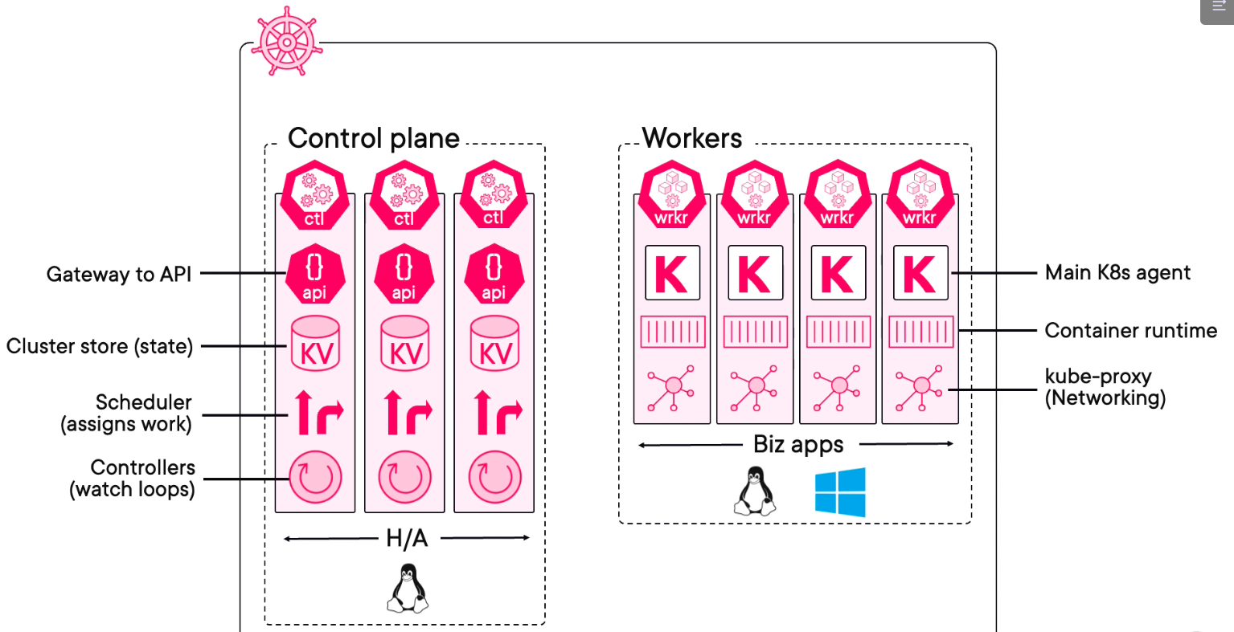
Nodes:

Slide 8
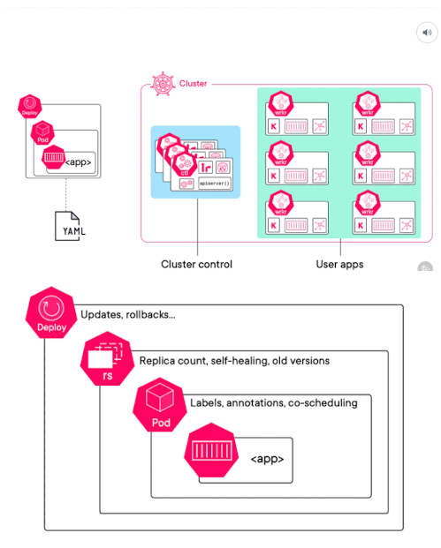
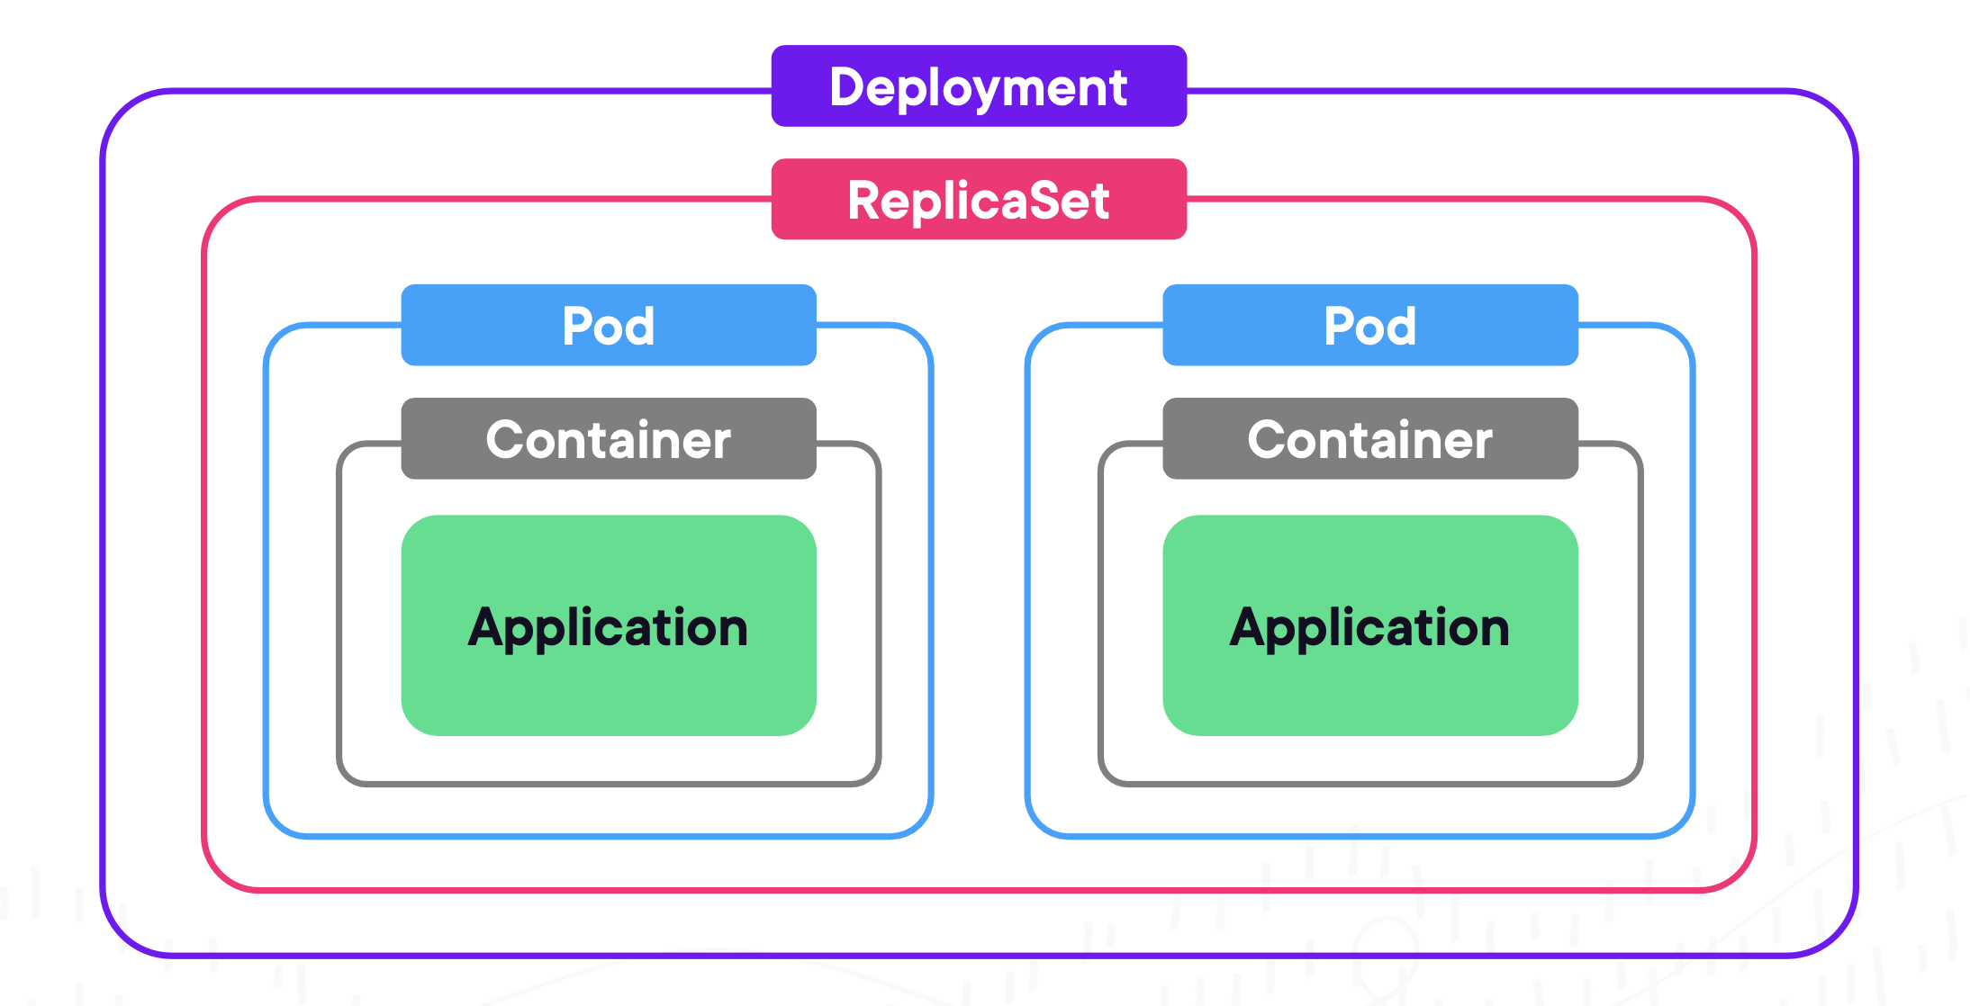
Deployment VS ReplicaSet

Slide 9
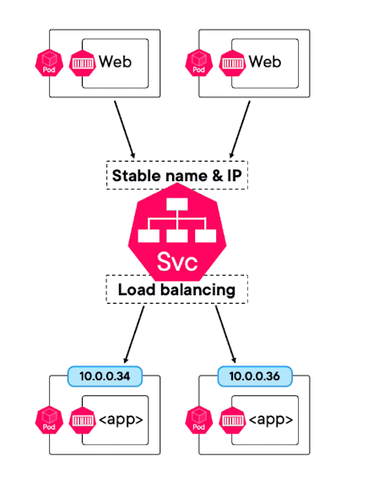
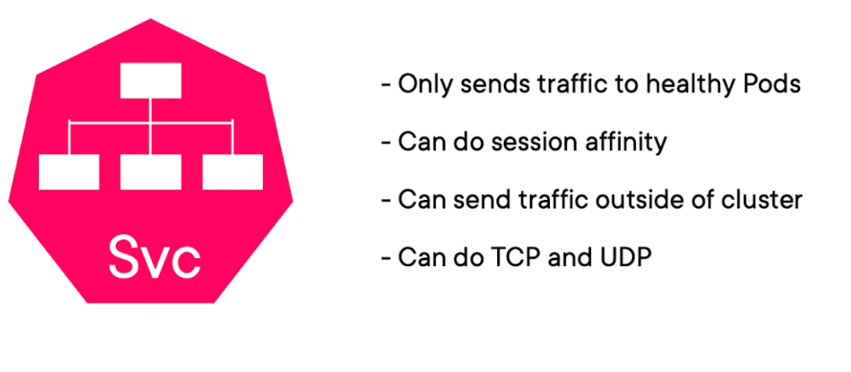
How to make deployment available:

Slide 10
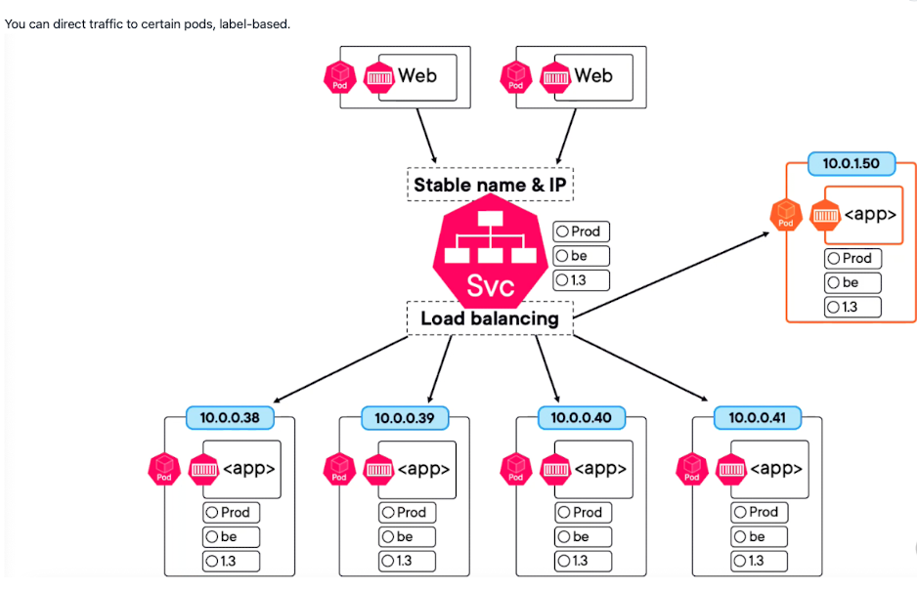
Why labels are important:

Slide 11
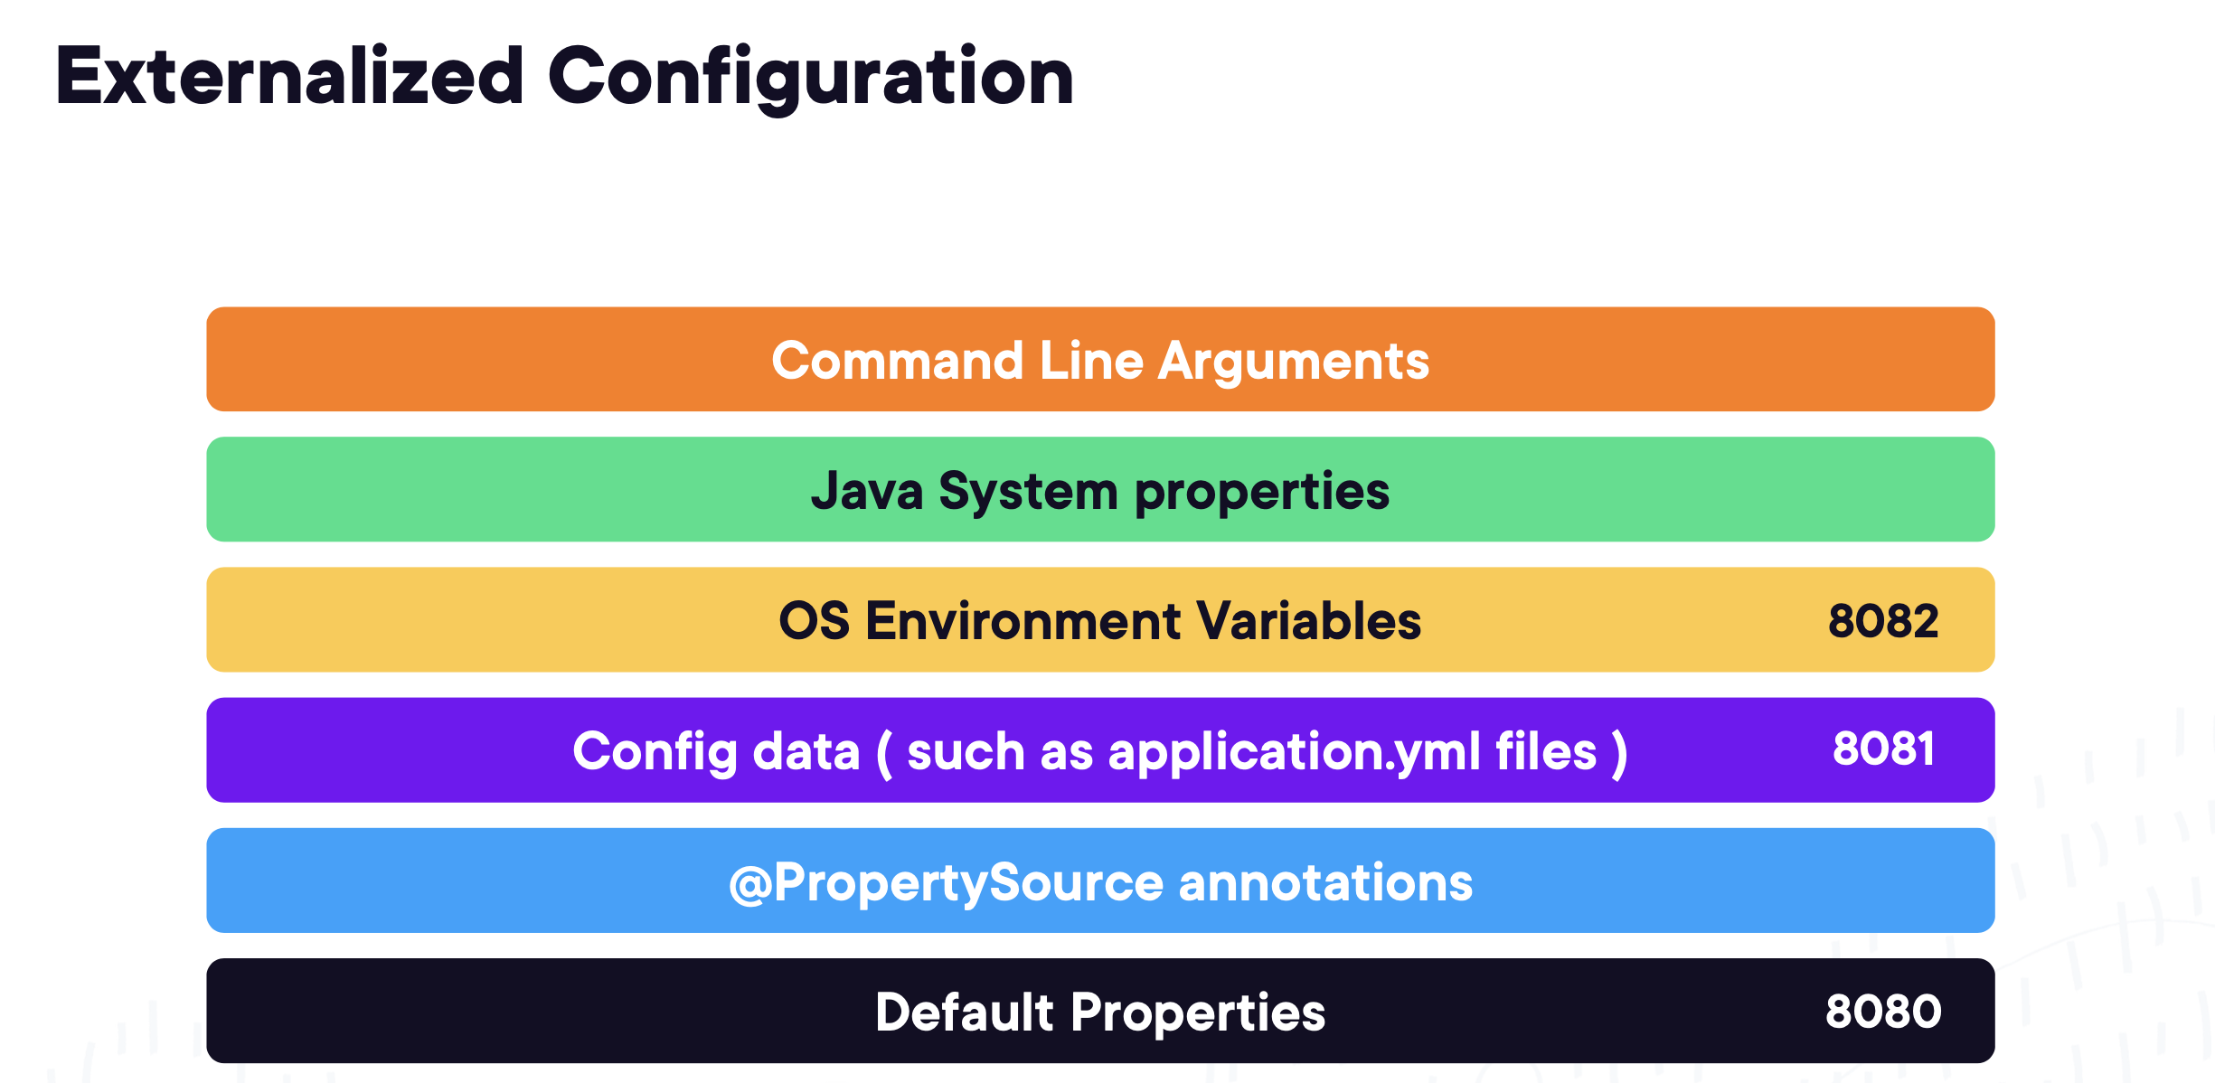
Precedence order:

Slide 12
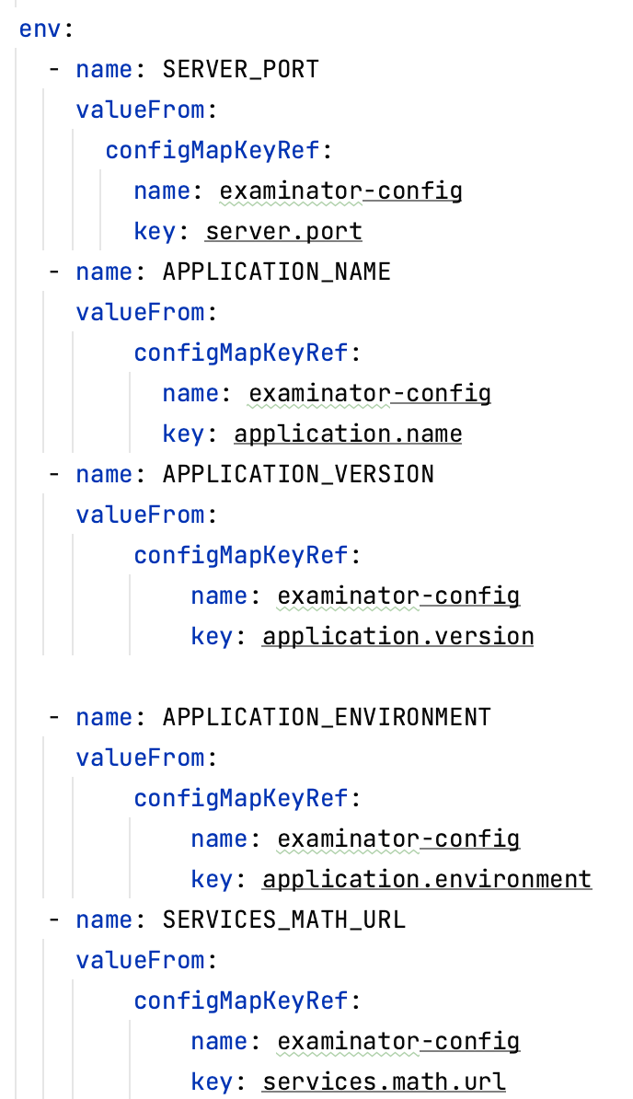
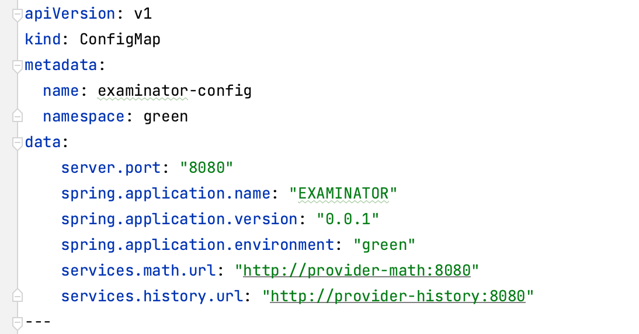
ConfigMaps:

Slide 13
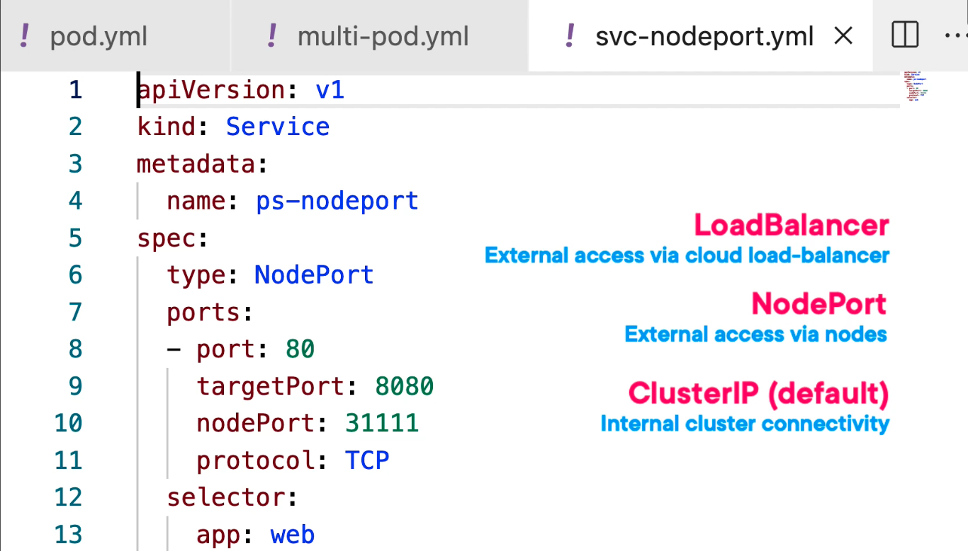
Ingress:

Slide 14
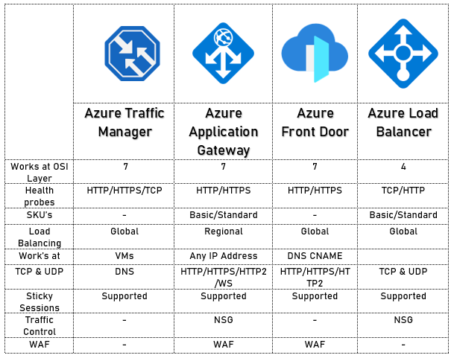
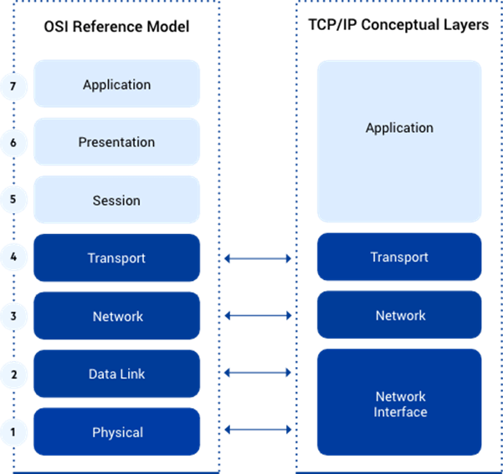
L4 vs L7 ingress:

Slide 15
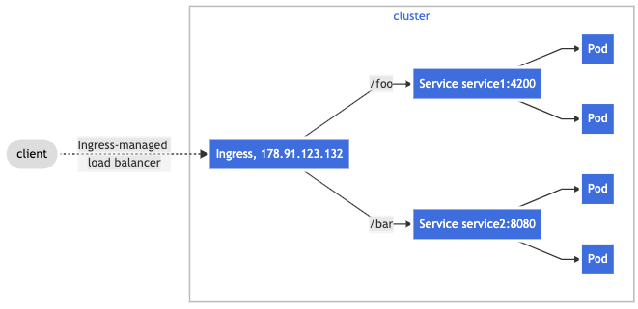
Putting it all together:

Slide 16
Recap:
Containers go into Pods
Which come in Replicasets created by Deployments
And read their config from ConfigMaps
Which are routed to via Services
Which are exposed either via LoadBalancers (L4) or Ingress (L7)
All these things are expressed in manifests because your tinkering will be overridden with the Cluster controller to achieve target state

